Slide 1

RELIABILITY ASSESSMENT OF JQC‑3FC (T73) SPDT RELAY
PRESENTED BY –
LT CDR ARAVIND MANIKANDAN (25RE61D01)
KADIMI TARUN (25RE61R05)
SUTAMA SARKAR (25RE61R07)
RELIABILITY TESTING LABORATORY
AUTUMN SEMESTER 2025-26
1

Slide 2
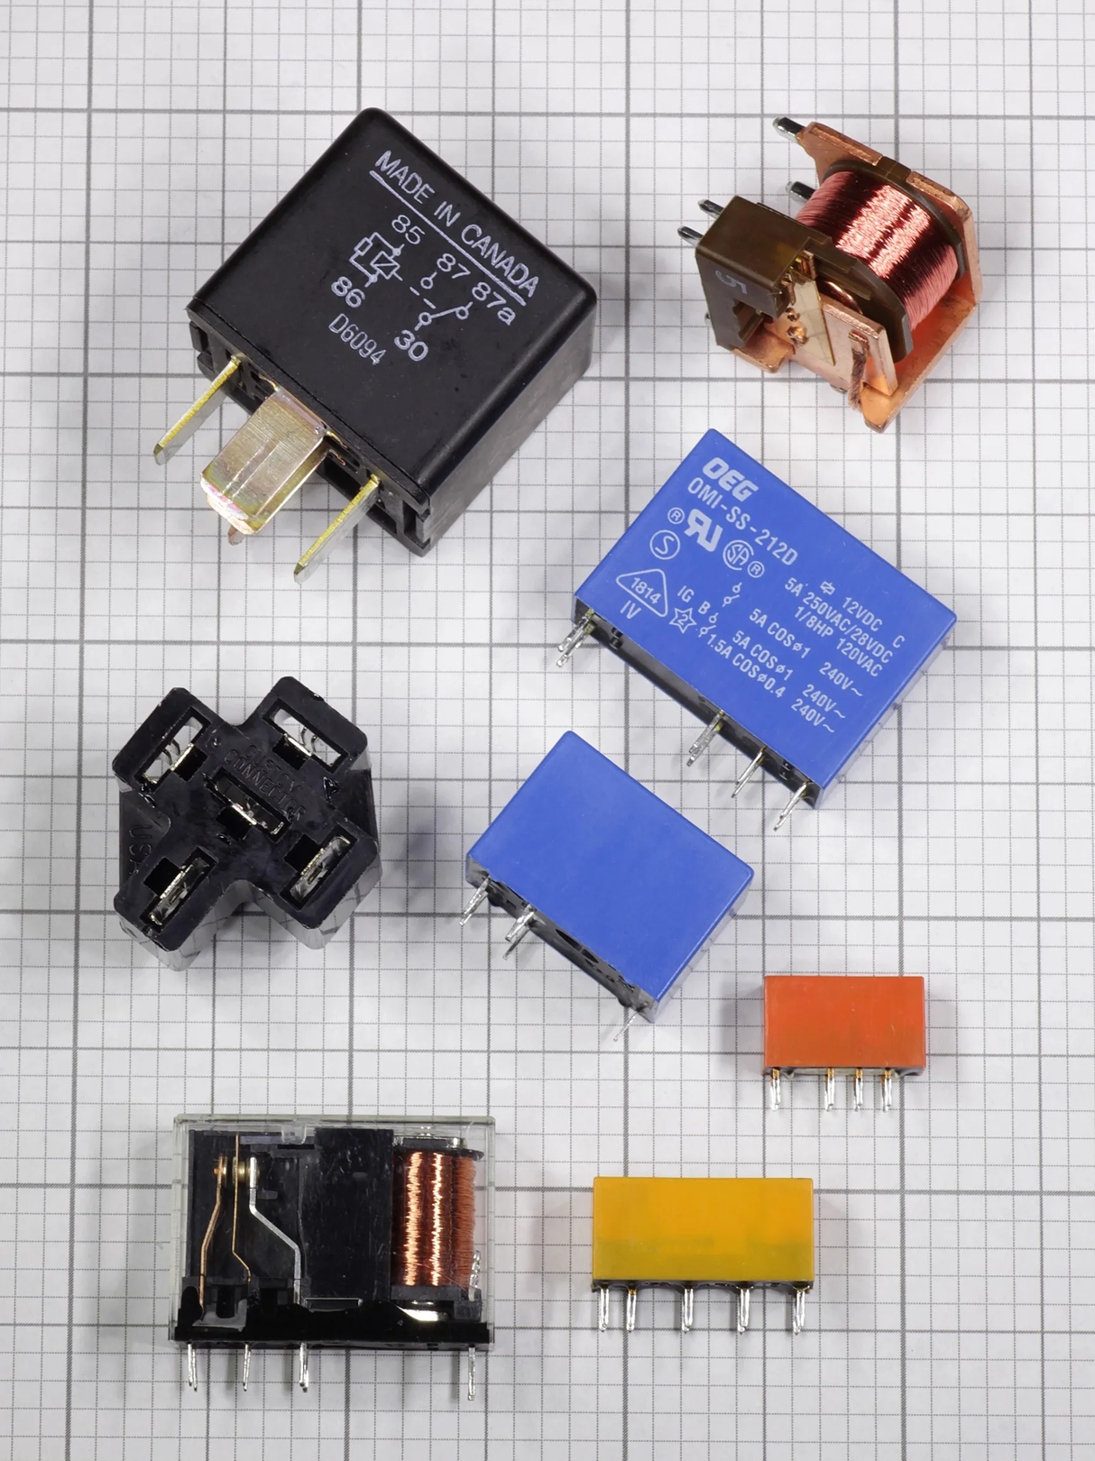
Scope
1. Introduction
2. Test Methodology
3. Data Modelling (Weibull + Arrhenius)
4. Results and Reliability Estimates
5. Inferences
6. Conclusions
7. Recommendations
2

Slide 3
Introduction
OBJECTIVE: Assess relay lifetime using elevated-temperature ie accelerated testing.
Stress
Temperatures
Goal
403 K, 393 K, 363 K
Estimate lifetime
and reliability
at normal use condition
Relay Model
Load
1A resistive (10 bulbs), 5s ON / 10s OFF duty cycle
DL JQC‑3FC (T73)
DC05V (5‑pin, blue casing)
Mechanical life : 10 million cycles
3

Slide 4
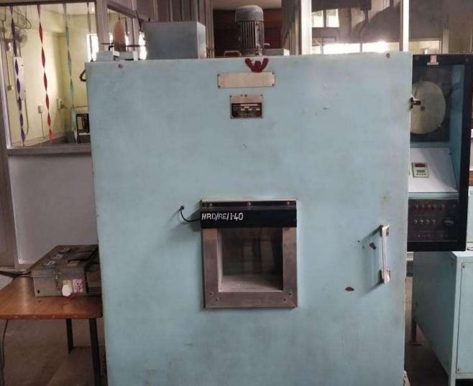
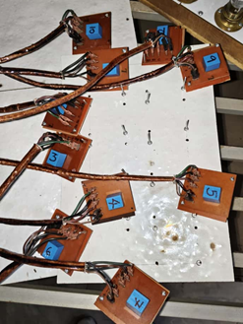
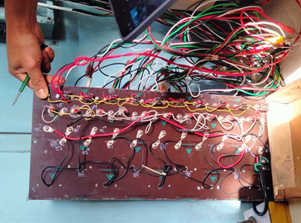
Introduction
Thermal Chamber
Preparation of Test Set Up
Relay Main Circuit Board

Slide 5
Test Methodology
Data collected at 3 temperatures until failure
01
02
Probability Paper Plotting to determine best dstr fit
03
Common β applied using pooled estimation
Arrhenius model used: ln(θ) vs 1/T
04
Activation Energy (Ea) and Acceleration Factors (AF) computed
05
5

Slide 6
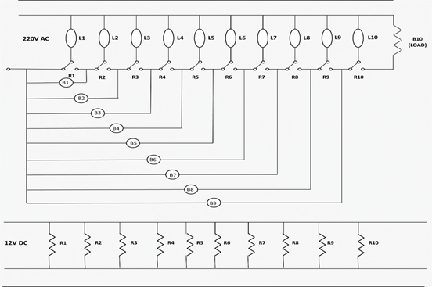
Circuit Diagram
R=Relay
B=Bulb
L=Indicators
6

Slide 7
Test Result
Test data at 403K
Test data at 393K
Test data at 363K
Relay No. | Failure times (cycles)
R2 | 2724
R9 | 3324
R6 | 3765
R5 | 4457
R10 | 5433
R1 | 6088
R3 | 6822
R4 | 7699
R8 | 8250
R7 | 8542
Relay No. | Failure times (cycles)
R2 | 3022
R10 | 3627
R4 | 4956
R7 | 5416
R3 | 6612
R1 | 7210
R5 | 8342
R8 | 9076
R6 | 10549
R9 | 11351
Relay No. | Failure times (cycles)
R1 | 5568
R9 | 7123
R4 | 8476
R6 | 9920
R8 | 11042
R3 | 12457
R2 | 13843
R7 | 15321
R5 | 16455
R10 | 17863
All failures are observed in short circuit mode

Slide 8
Distribution Fitting of the Failure Times using Least Square Estimation (LSE) Method
LSE of Failures Observed at 403K
8

Slide 9
LSE of Failures Observed at 393K
9

Slide 10
LSE of Failures Observed at 363K
It can be observed from the above figures that the coefficient of correlation is higher and closest to 1 for Weibull distribution
10

Slide 11
Weibull Distribution Parameters for Failures at different Temperatures
Shape and Scale Parameter for Test Temperatures
Temperature (in K) | Shape Parameter | Scale Parameter (in cycles)
403 | 2.734 | 6456.61379
393 | 2.499 | 7967.11698
363 | 2.917 | 13289.6164
11

Slide 12
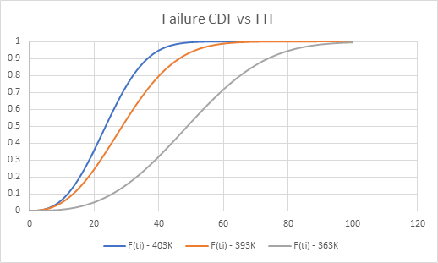
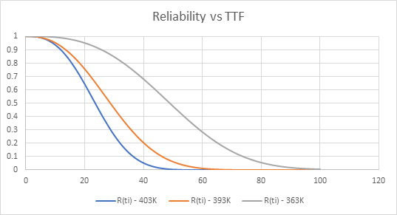
Failure CDF Plot vs TTF( hrs ) at different Test
Temperatures
Reliability Plot vs TTF( hrs ) at different Test Temperatures
12

Slide 13
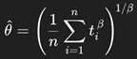
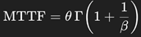
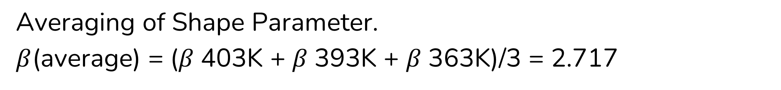
Determination of Acceleration Factor Graphically.
Averaging of Shape Parameter.
$β$(average) = ($β$403K + $β$393K + $β$363K)/3 = 2.717
Revised Scale Parameter is calculated using
Maximum Likelihood Equation
The MTTF values are calculated
using formula
13

Slide 14
Revised Parameter Values for Test Temperatures
Temperature (in K) | Shape Parameter | Scale Parameter (in hrs) | Mean Time to Failure (in hrs)
403 | 2.717 | 6260.16 | 5568
393 |  | 7817.70 | 6954
363 |  | 12824.19 | 12824
14

Slide 15
Arhenius Plotting of ln (θ) vs Stress (1/T)
ln(θ) = ln A + B/T
ln A = 2.4286
A = 11.34
B = Ea/R = 2555
Activation Energy =
Ea = 2555 x 8.617 x 10^-5 = 0.22016 eV
15

Slide 16
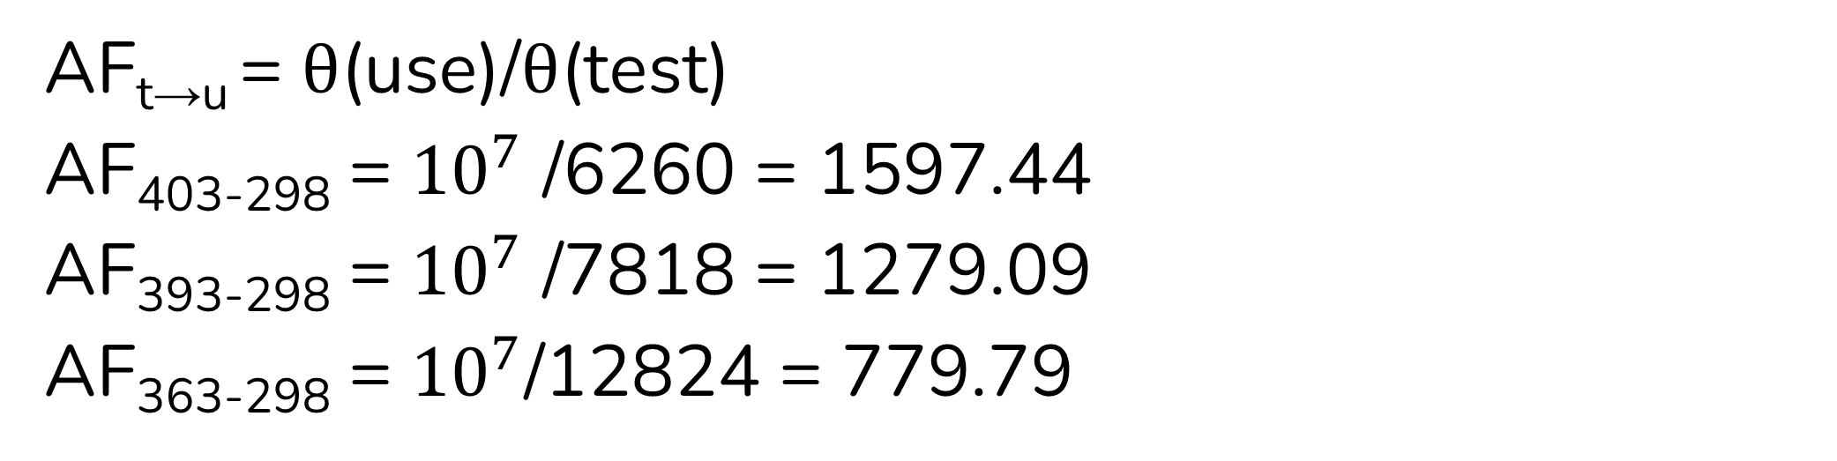
Acceleration Factors (AFs)
AFs are calculated as below and the normal use life of Relays observed in above three experiments are as below
AF_{t→u} = θ(use)/θ(test)
AF₄₀₃₋₂₉₈ = ${10}^{7}$ /6260 = 1597.44
AF₃₉₃₋₂₉₈ = ${10}^{7}$ /7818 = 1279.09
AF₃₆₃₋₂₉₈ = ${10}^{7}$/12824 = 779.79
16

Slide 17
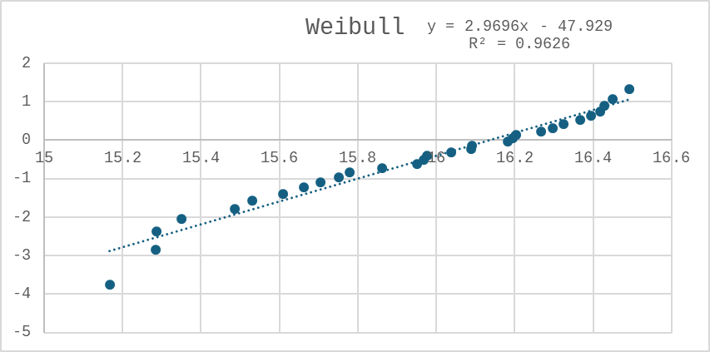
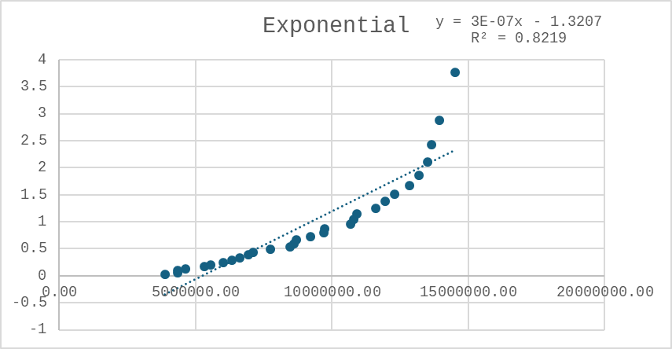
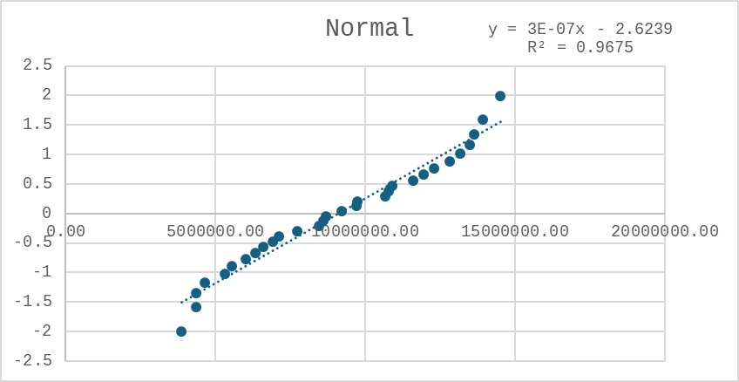
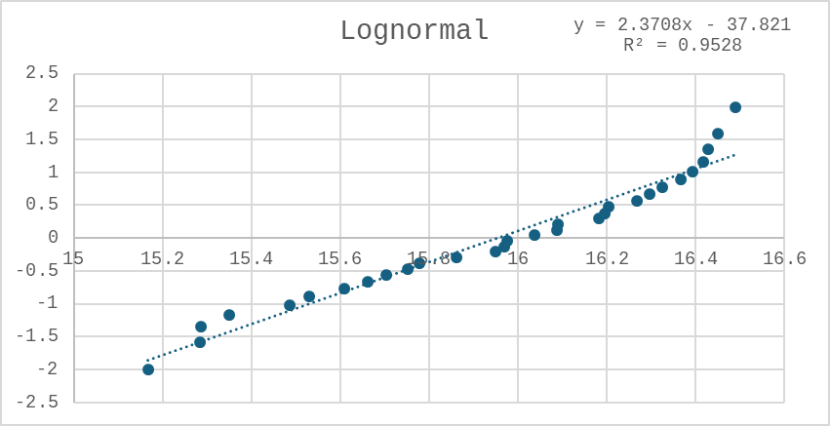
LSE Fitting of Cumulative Failure data
The cumulative failure data fits Normal Distribution the best

Slide 18
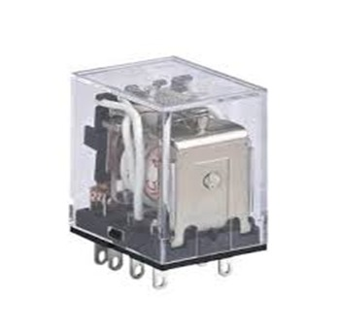
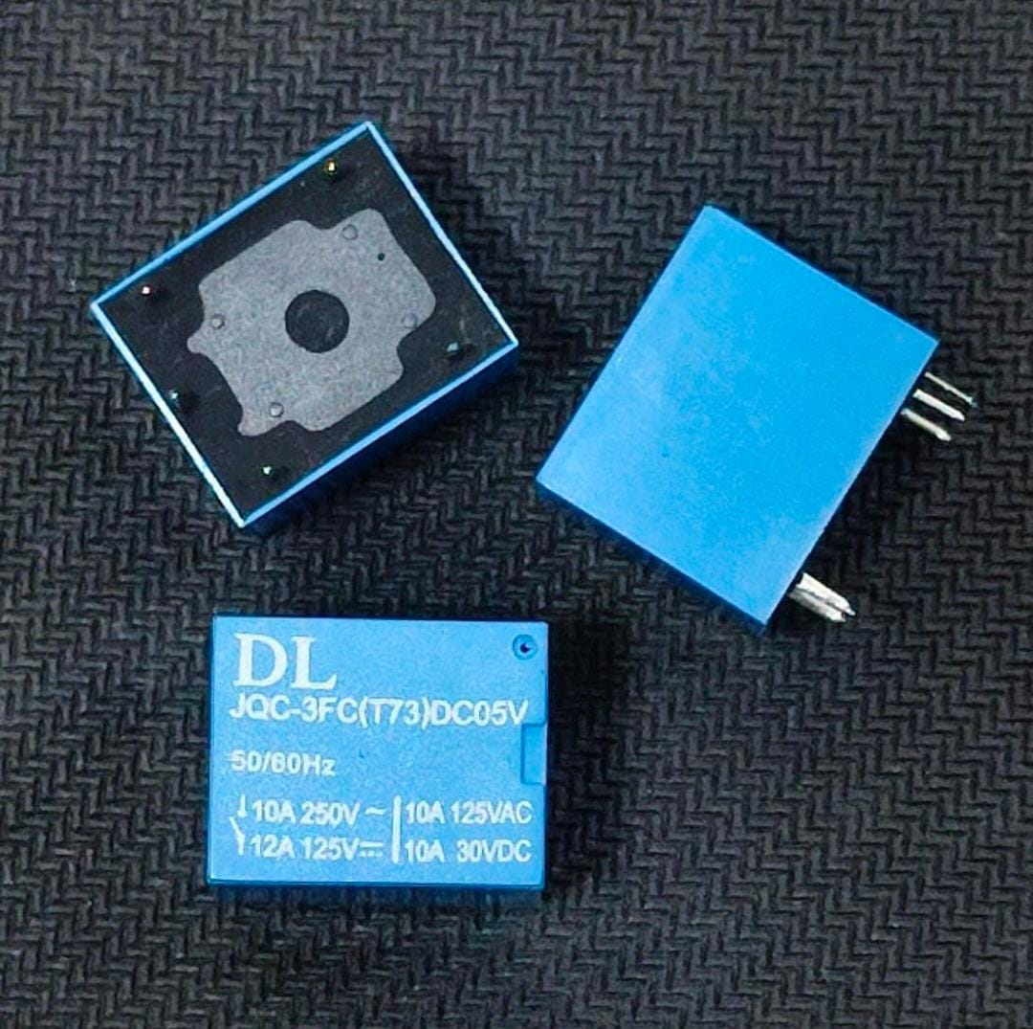
Inferences
•Overall Failure pattern follows the Normal distribution best
•Arrhenius modelling fits strongly with ln(θ) vs 1/T.
• The mean life of relays as observed from Normal Distribution (of complete failure data) is 8746333 cycles.
18

Slide 19
Conclusion
•Relay life decreases rapidly with temperature and switching rate
•Estimated mean life under normal use condition is 8746333 cycles
vis-à-vis OEM established life of 10 million cycles
•Failures were dominated by contact wear out
•Relay endurance is strongly influenced by temperature, load and cycle rate
19

Slide 20
Recommendations
•Matching switching cycle to real‑world conditions
•Improving chamber calibration and uniform airflow
•Usage of wider temperature spacing with larger samples
20

Slide 21
THANK YOU
21

